Slide 1
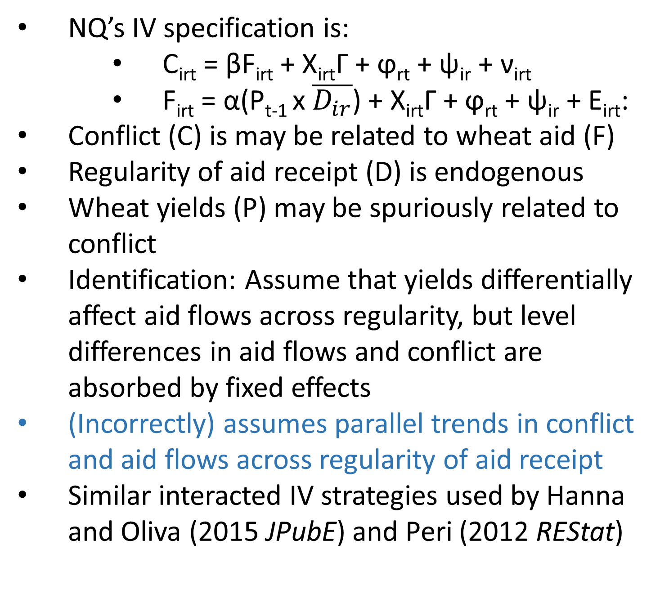
Revisiting Food Aid and Civil Conflict:
Spurious Trends in Interacted Instrumental Variables
Paul Christian and Christopher B. Barrett
US Food Aid and Civil Conflict
Changes in US Wheat Policies
Simulating Spurious Results
Nunn and Qian (2014 AER) claim US wheat aid deliveries cause conflict in recipient countries
NQ use an Instrumental Variables (IV) strategy based on the claims that:
High US wheat yields oblige the USDA to purchase excess wheat supply
Higher accumulated stocks allow the US to distribute more wheat aid
Regular recipients of aid receive most of the surplus
Identification: “US wheat production is associated with more conflict among regular US food aid recipients, but not among irregular recipients”
Historically, wheat yields were linked to USDA procurement through non-recourse commodity loans
But Farm Bills in the 1980’s and 90’s weakened and eventually eliminated link between wheat yields and food aid
Therefore, if NQ results were truly causal, they should be strongest prior to 1996 farm bill
If anything, results are stronger after 1996
This suggests that procurement policies did not drive results; the results may be spurious.
Monte Carlo simulation:
Assumes spurious trends
W/ no true causal effect of aid on conflict, NQ strategy yields upwardly biased IV
Interacted IV Strategy
Spurious Trends in the Data
Conclusions
NQ’s IV specification is:
C_{irt} = βF_{irt} + X_{irt}Γ + ϕ­_{rt} + ψ_{ir} + ν_{irt}
F_{irt} = α(P_{t-1} x $\overline{D_{ir}}$) + X_{irt}Γ + ϕ­_{rt} + ψ_{ir} + Ε_{irt}:
Conflict (C) is may be related to wheat aid (F)
Regularity of aid receipt (D) is endogenous
Wheat yields (P) may be spuriously related to conflict
Identification: Assume that yields differentially affect aid flows across regularity, but level differences in aid flows and conflict are absorbed by fixed effects
(Incorrectly) assumes parallel trends in conflict and aid flows across regularity of aid receipt
Similar interacted IV strategies used by Hanna and Oliva (2015 JPubE) and Peri (2012 REStat)
Nunn and Qian (2014) results seem to be driven by non-linear long term trends that differentially affected regular recipients of aid
Spurious non-linear correlation is analogous to non-parallel trends in Diff-in-Diff estimation; confounding is not absorbed by fixed effects
Given these trends, we show in Monte Carlo simulation that it is possible to find a positive IV relationship between food aid and conflict even if aid prevents conflict.
Similar issues could bias estimates using this interacted IV strategy in other contexts
When using a similar strategy, researchers should report trends in both components of the interaction term in first stage as a diagnostic.
Results may be explained by non-linear, non-parallel trends in wheat, conflict, and aid that NQ’s interacted IV strategy cannot control for.

